Slide 1


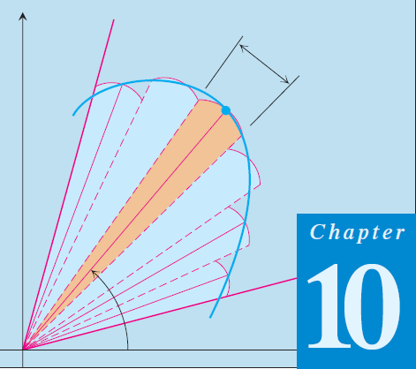
01
Thomas Calculus 11th
01
Polar Coordinates Introduction
Samuel Lukas

Slide 2


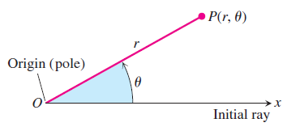
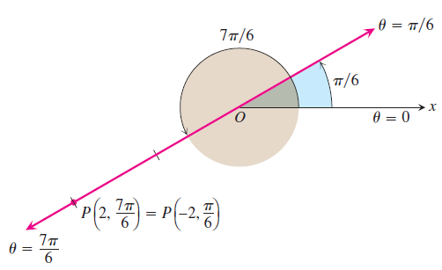
Definition of Polar Coordinates

Slide 3
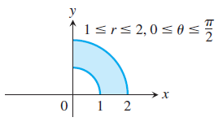
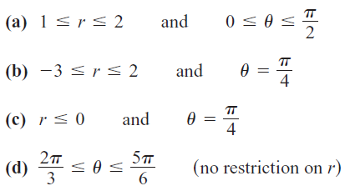
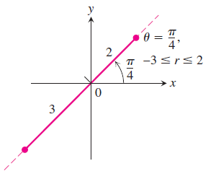
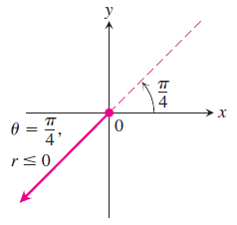
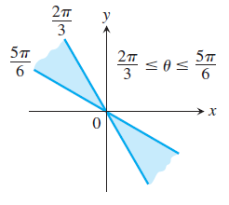
Polar Equations and Graphs

Slide 4
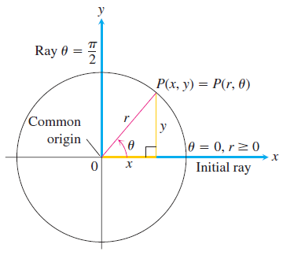

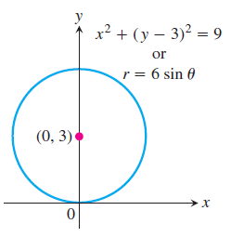

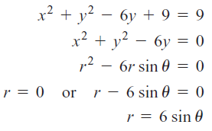
Converting Cartesian to Polar

Slide 5





Converting Polar to Cartesian

Slide 6
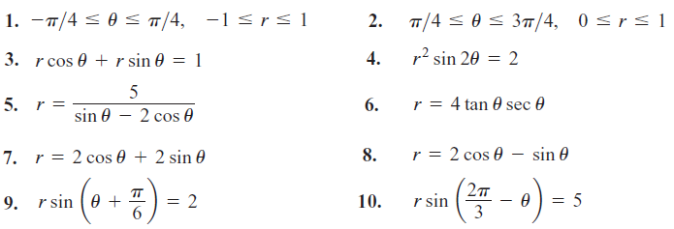
Exercises 1
Graph the sets of points whose polar coordinates satisfy the equations and inequalities by converting into cartesian.

Slide 7


Symmetry Tests for Polar Graphs

Slide 8
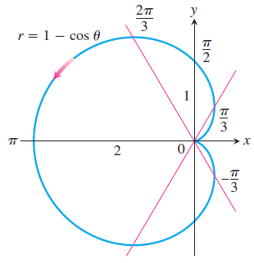

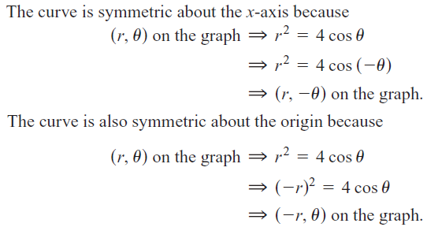
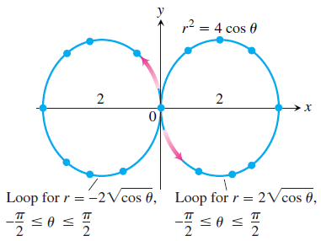
Example 1

Slide 9


Slope of Polar Coordinates

Slide 10

Exercise 2
Identify the symmetries of the curves then sketch the curves.
Find the slopes of the curves at the given points then sketch the curves along with their tangents at these points.

